Slide 1
TDCV Project 1: Keypoint based object detection, pose estimation and refinement
Task 1: Model Preparation
Mai Bui, Ivan Shugurov and Roman Kaskman

Slide 2
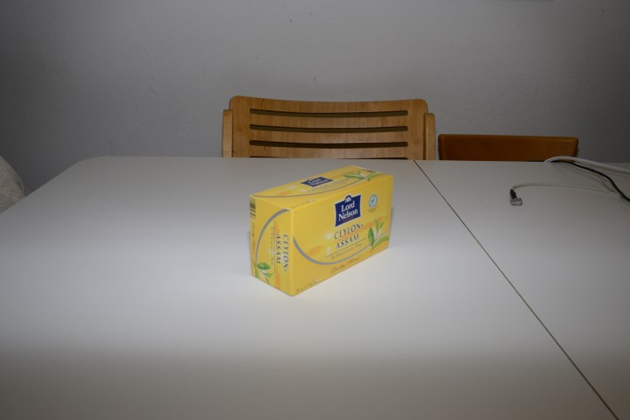
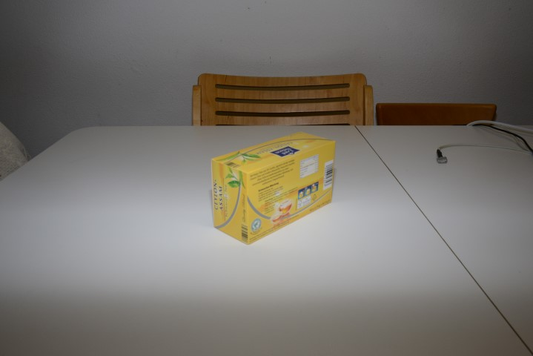
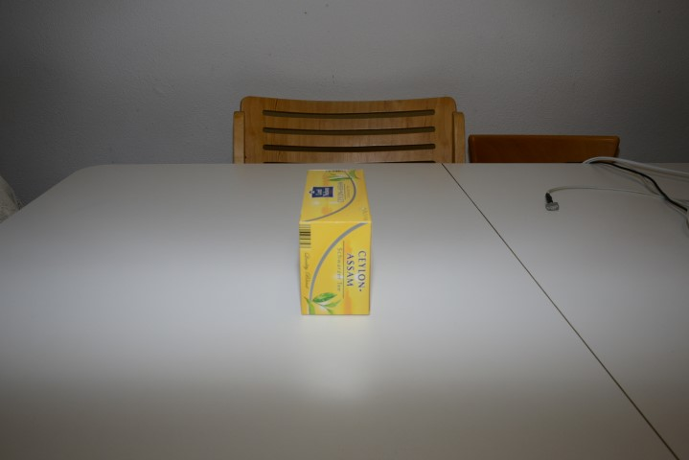
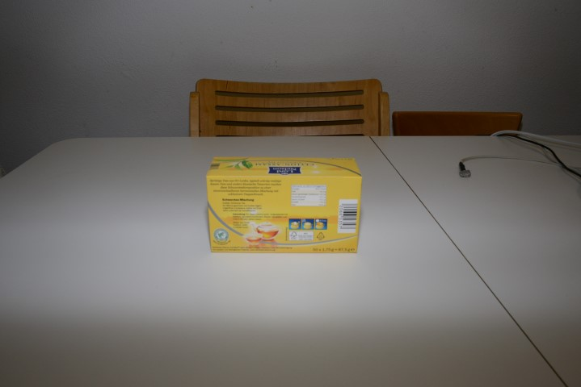
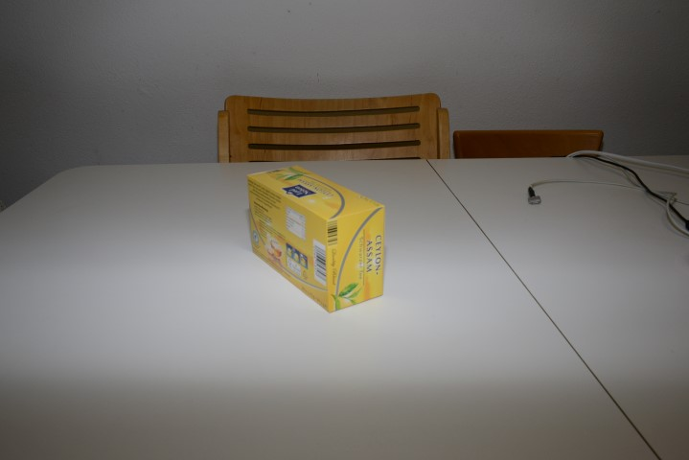
Overall goal: automatic pose estimation
Given the camera images
and 3D model
…
Z
Y
X
We want to determine the pose of
the camera filming the object so that
the 3D model of the object re-projects
(overlays) correctly in the images.

Slide 3
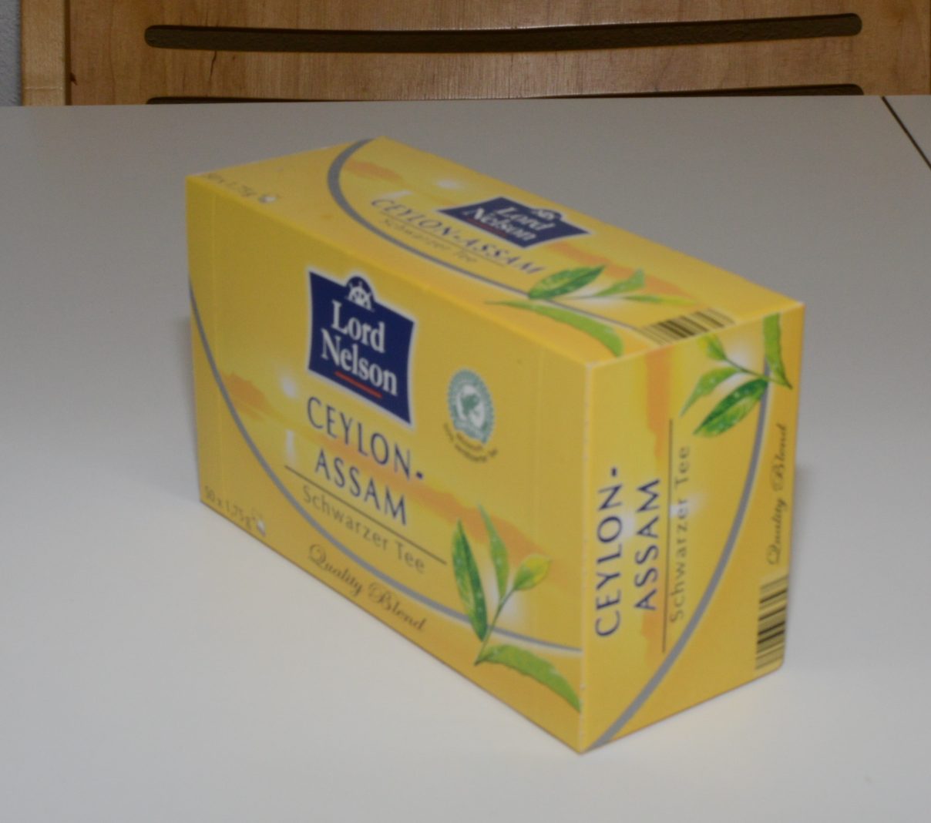
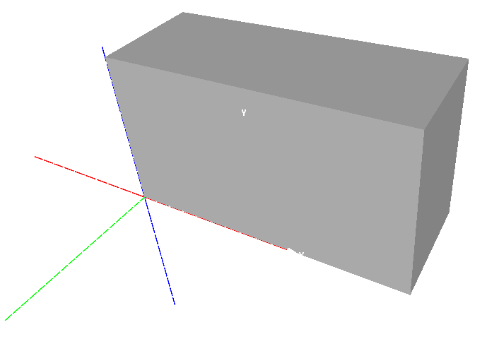
Manual pose estimation for training images
(0,0,0)

Slide 4
Expected output after PnP
The camera poses shown as above is something what you need to obtain as a result.

Slide 5

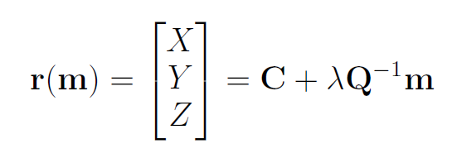
From SIFT features in the image to their corresponding 3D points on the model
M
Given:
2D feature points m
Camera poses [R|t] described
with the projection matrix P=[Q|q]
Determine:
3D points M on the provided
model in world coordinate system
Take care about:
which faces of the model are
Visible by using face normals
m
r
C

Slide 6
Expected output
3D points on the model corresponding to extracted SIFT features in the image.

